Slide 1
Malignant Comments Classifier Project
BY: Archana Kumari

Slide 2
Business Problem Framing
The proliferation of social media enables people to express their opinions widely online. However, at the same time, this has resulted in the emergence of conflict and hate, making online environments uninviting for users. Although researchers have found that hate is a problem across multiple platforms, there is a lack of models for online hate detection.
Online hate, described as abusive language, aggression, cyberbullying, hatefulness and many others has been identified as a major threat on online social media platforms. Social media platforms are the most prominent grounds for such toxic behaviour.
There has been a remarkable increase in the cases of cyberbullying and trolls on various social media platforms. Many celebrities and influences are facing backlashes from people and have to come across hateful and offensive comments. This can take a toll on anyone and affect them mentally leading to depression, mental illness, self-hatred and suicidal thoughts.
Internet comments are bastions of hatred and vitriol. While online anonymity has provided a new outlet for aggression and hate speech, machine learning can be used to fight it. The problem we sought to solve was the tagging of internet comments that are aggressive towards other users. This means that insults to third parties such as celebrities will be tagged as unoffensive, but “u are an idiot” is clearly offensive.
Our goal is to build a prototype of online hate and abuse comment classifier which can used to classify hate and offensive comments so that it can be controlled and restricted from spreading hatred and cyberbullying

Slide 3
Conceptual Background of the Domain Problem
In the past few years its seen that the cases related to social media hatred have increased exponentially. The social media is turning into a dark venomous pit for people now a days. Online hate is the result of difference in opinion, race, religion, occupation, nationality etc.
In social media the people spreading or involved in such kind of activities uses filthy languages, aggression, images etc. to offend and gravely hurt the person on the other side. This is one of the major concerns now.
The result of such activities can be dangerous. It gives mental trauma to the victims making their lives miserable. People who are not well aware of mental health online hate or cyber bullying become life threatening for them. Such cases are also at rise. It is also taking its toll on religions. Each and every day we can see an incident of fighting between people of different communities or religions due to offensive social media posts.
Online hate, described as abusive language, aggression, cyberbullying, hatefulness, insults, personal attacks, provocation, racism, sexism, threats, or toxicity has been identified as a major threat on online social media platforms. These kinds of activities must be checked for a better future

Slide 4
Motivation for the Problem Undertaken
The project was the first provided to me by Flip-Robo as a part of the internship programme. The exposure to real world data and the opportunity to deploy my skillset in solving a real time problem has been the primary objective. However, the motivation for taking this project was that it is relatively a new field of research. Here we have many options but less concrete solutions. The main motivation is to build a prototype of online hate and abuse comment classifier which can used to classify hate and offensive comments so that it can be controlled and restricted from spreading hatred and cyberbullying.

Slide 5
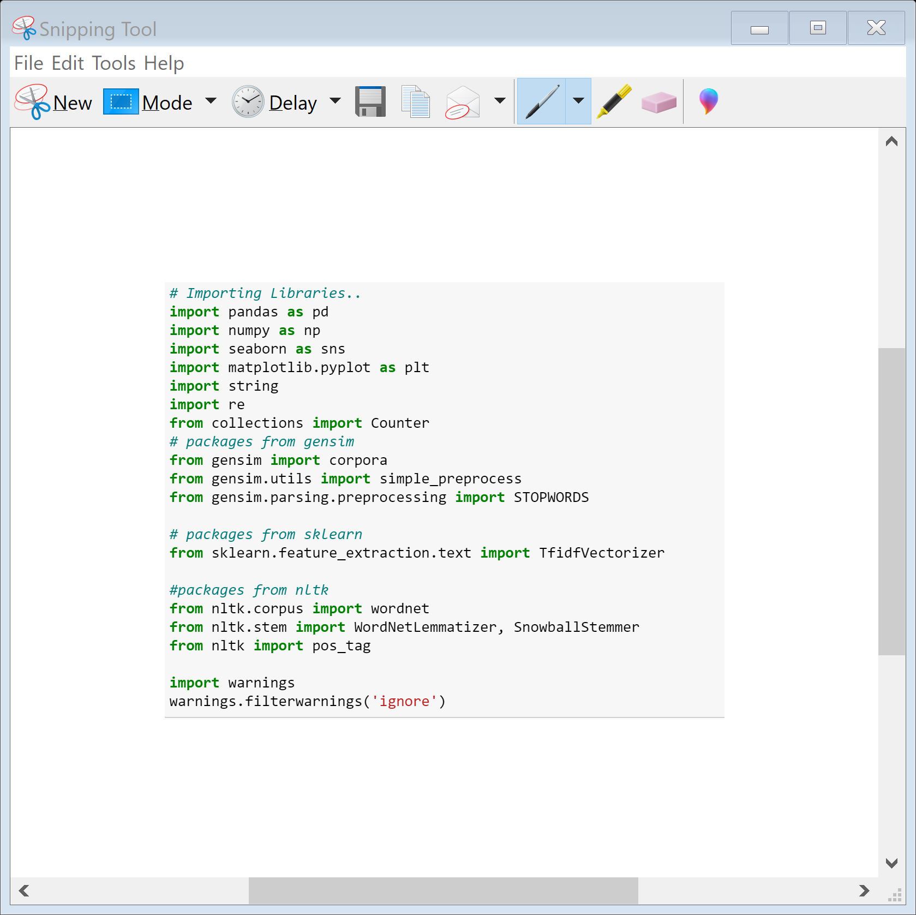
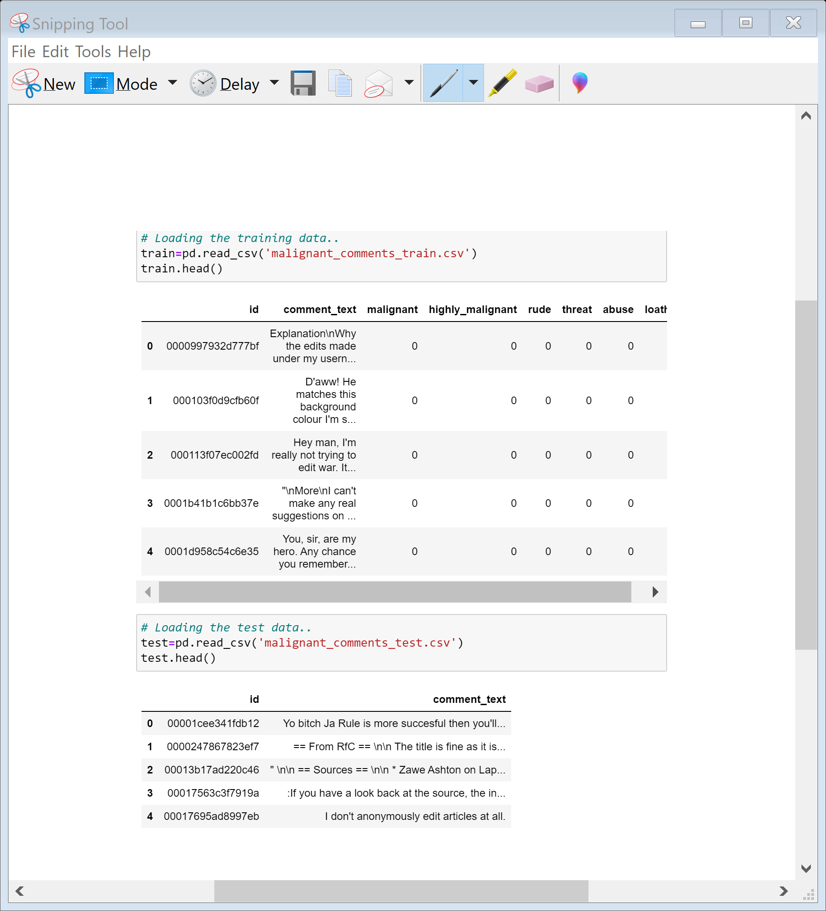
Loading Necessary libraries and Train and test dataset

Slide 6
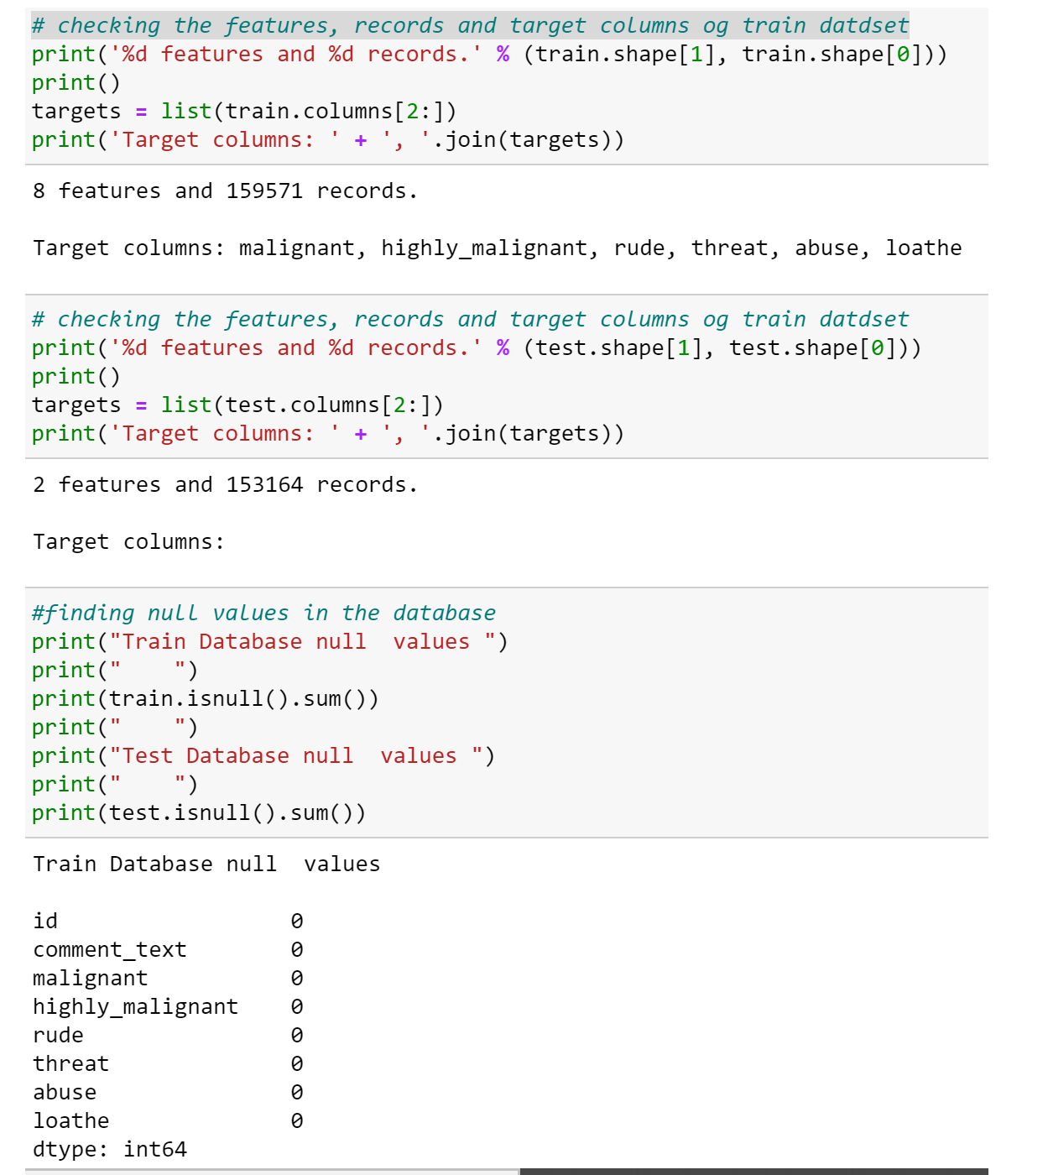
Let’s check the name of the columns , shape and information about the both dataset

Slide 7
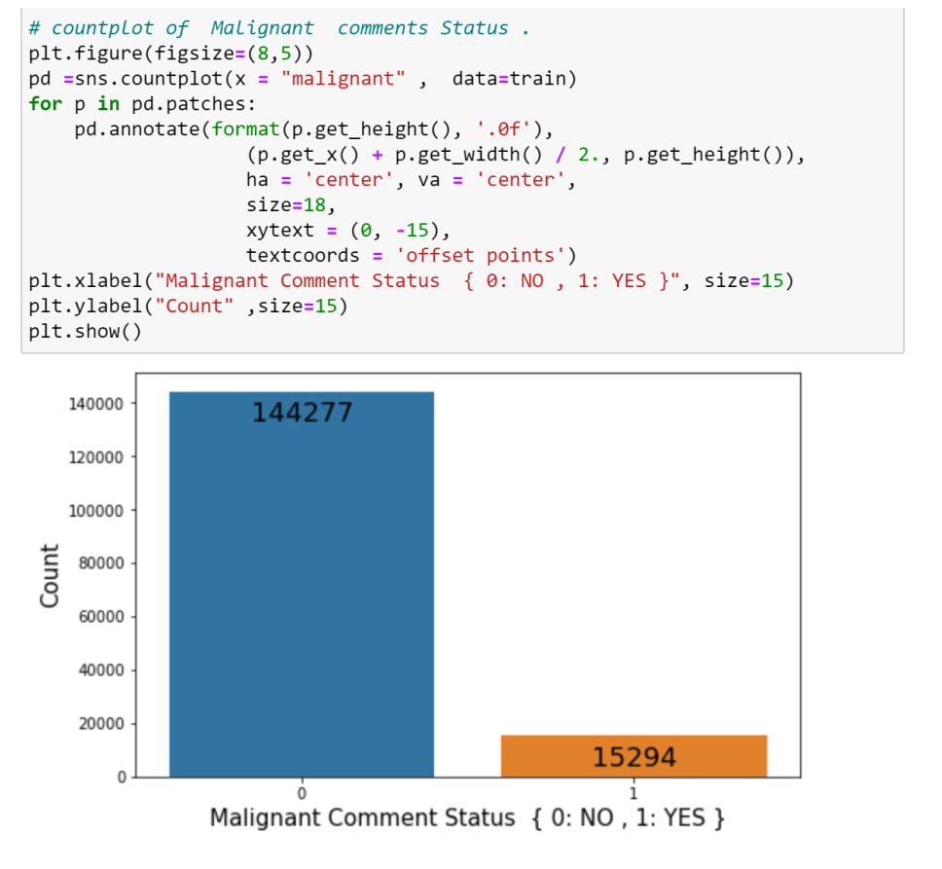
Visualization
Making Count-plot of Malignant Comments Status

Slide 8
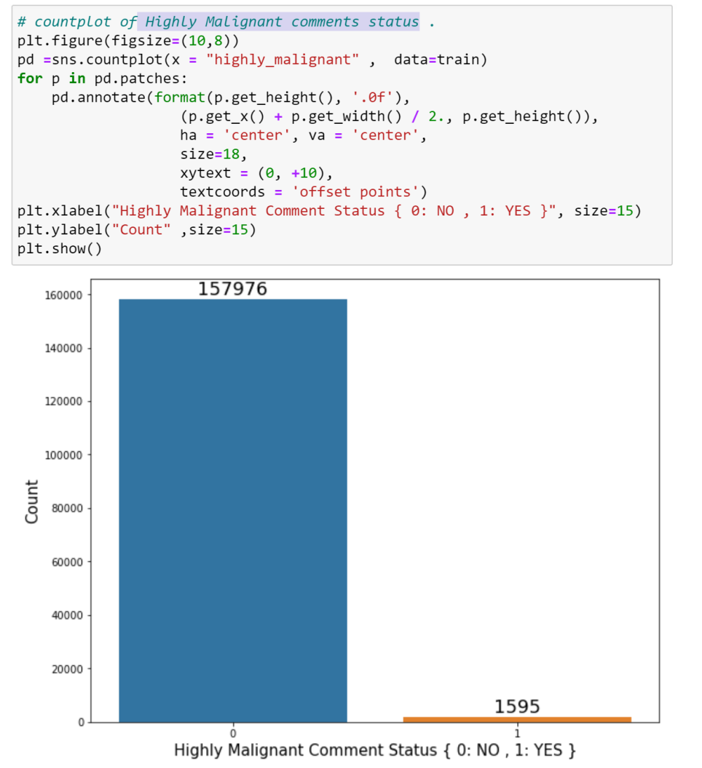
Making Count-plot of Highly Malignant comments status

Slide 9
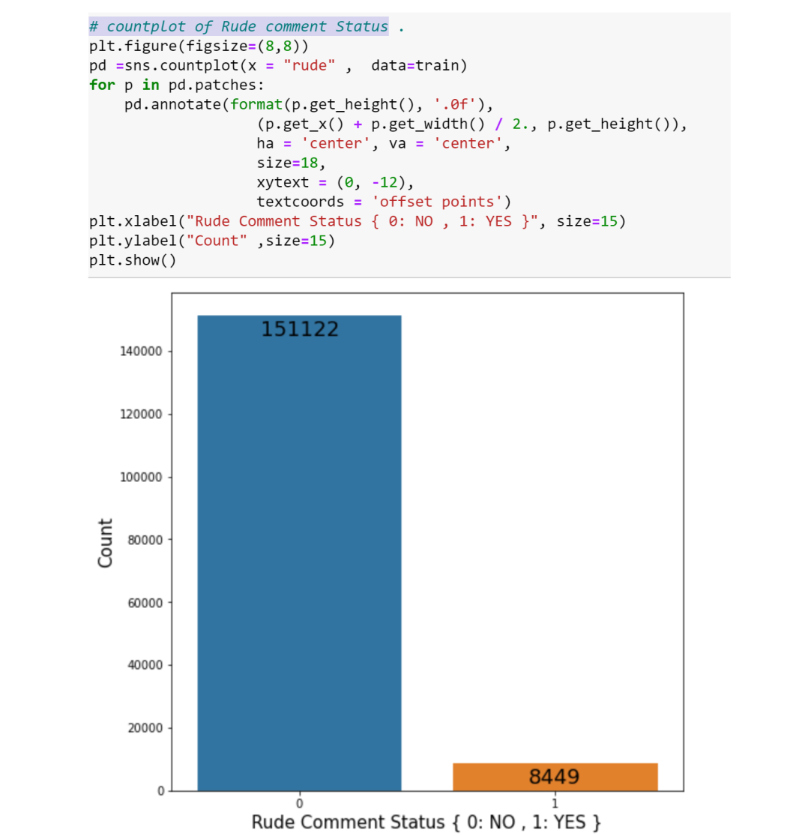
count plot of Rude comment Status

Slide 10
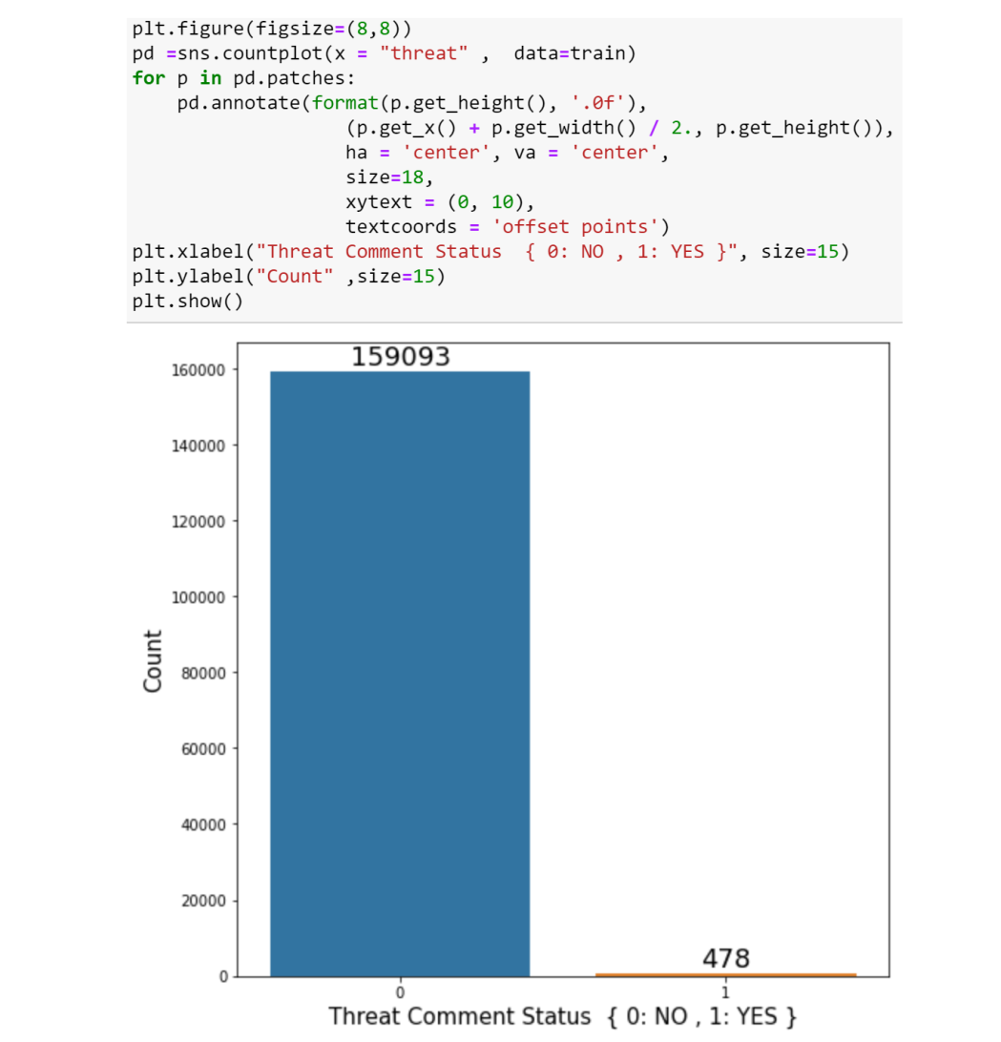
Count plot of Threat Comments Status

Slide 11
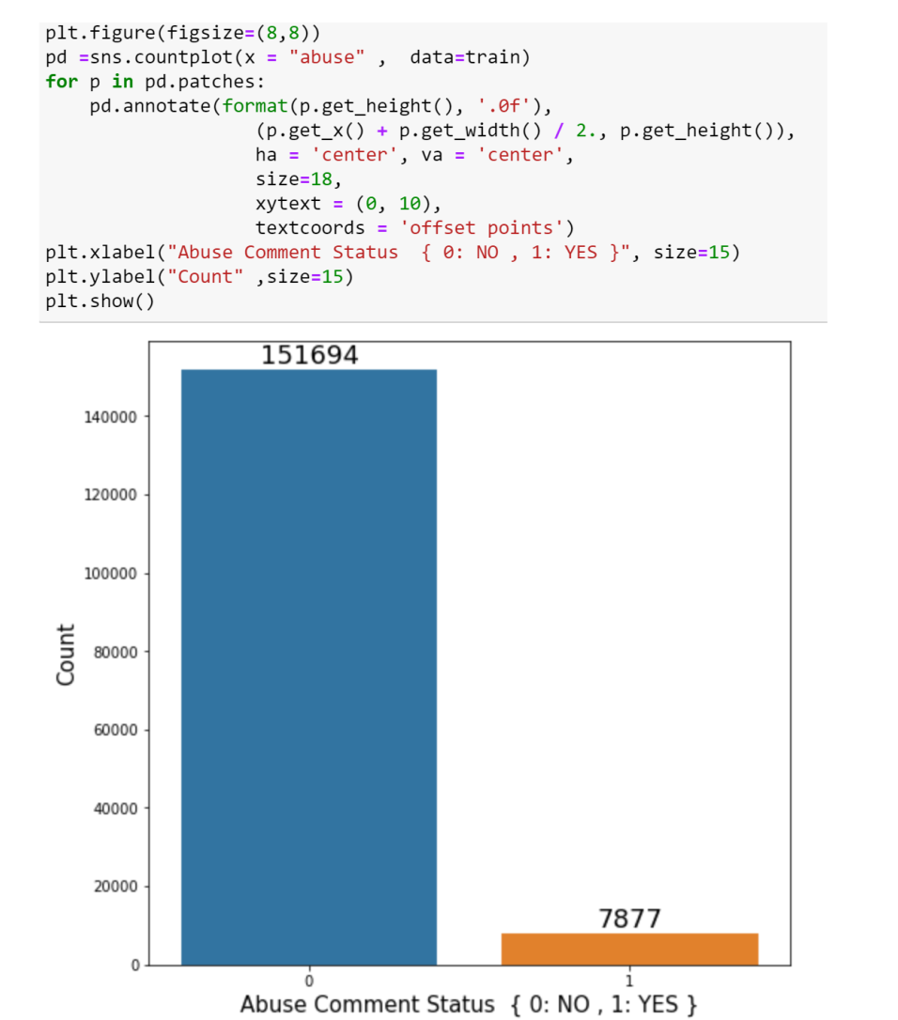
Count plot of Abuse Comment Status

Slide 12
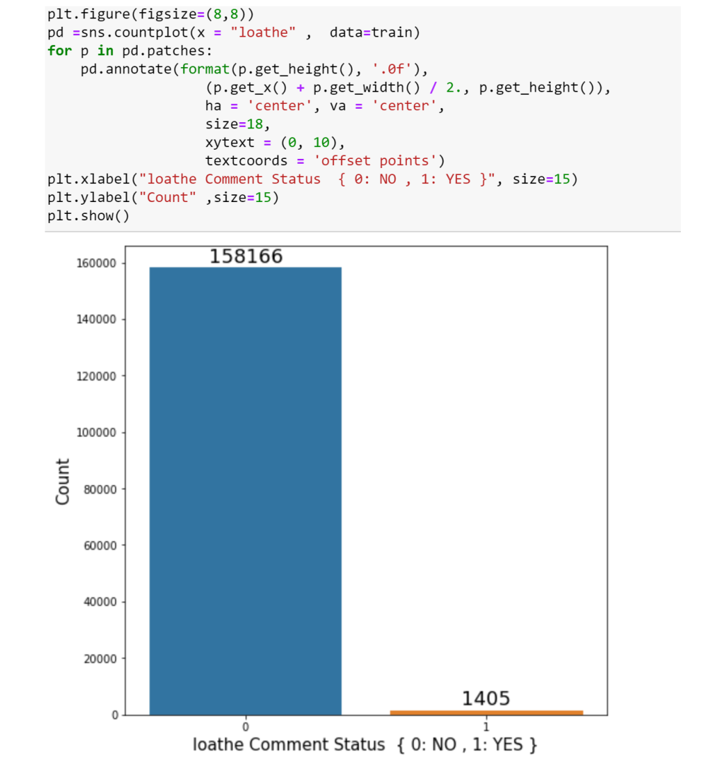
count plot of loathe Comment Status

Slide 13
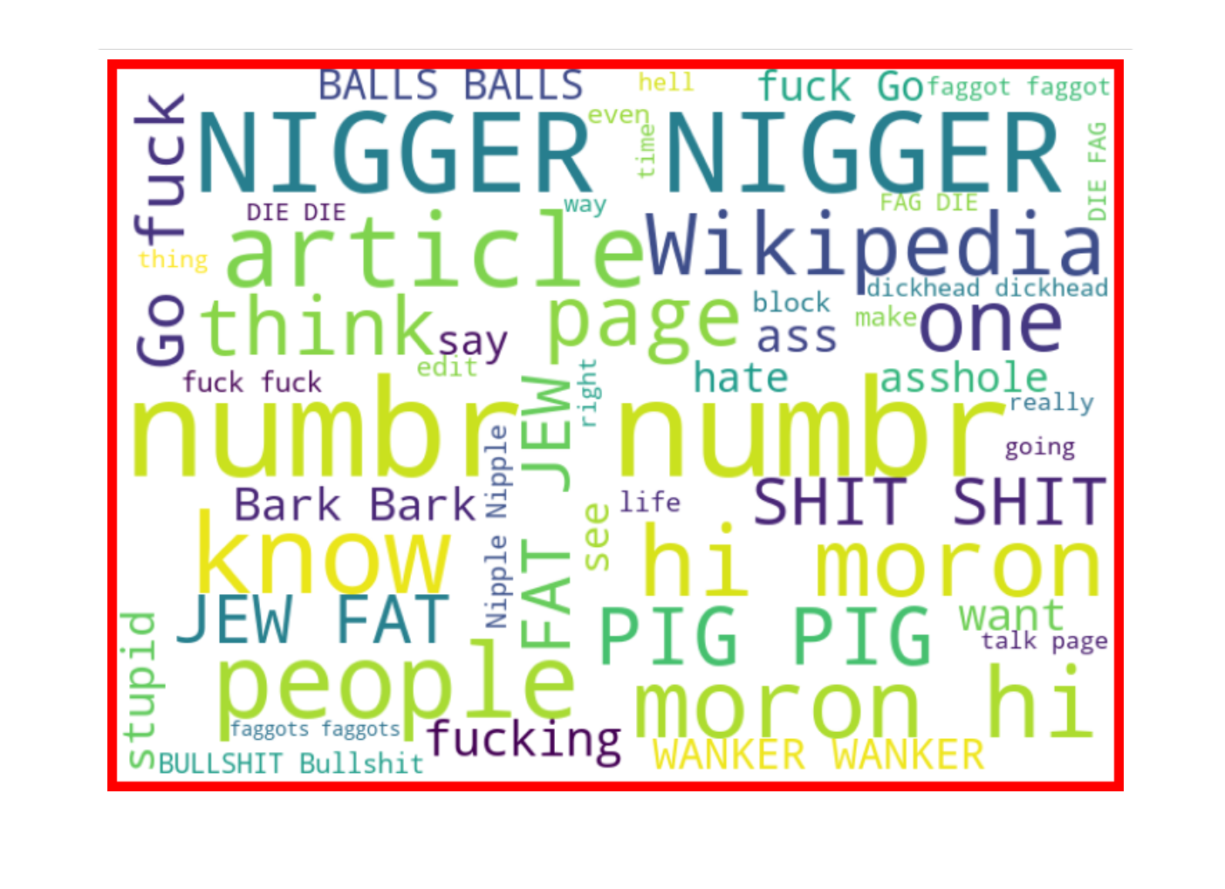
LET’S OBSERVE loud words in Comments which are marked as Malignant

Slide 14
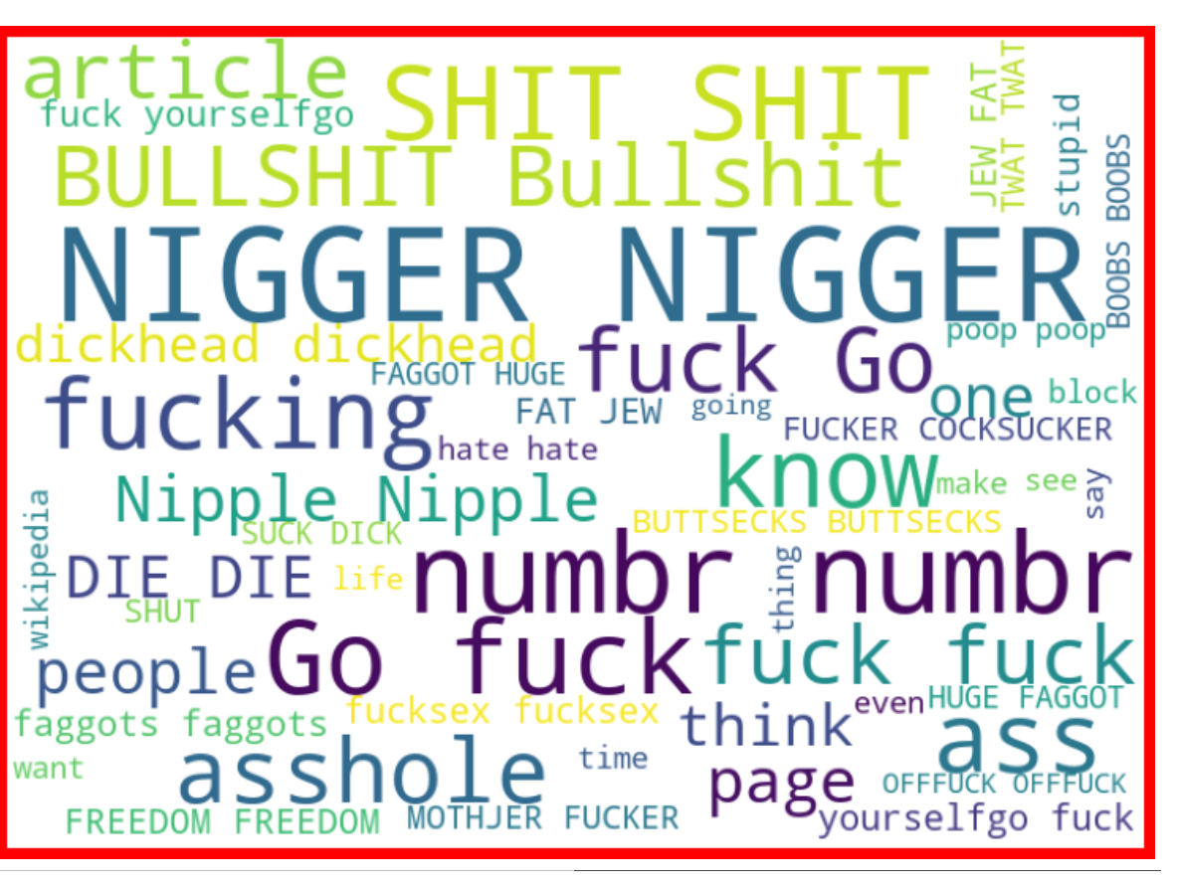
LET’S OBSERVE loud words in Comments which are marked as RUDE

Slide 15
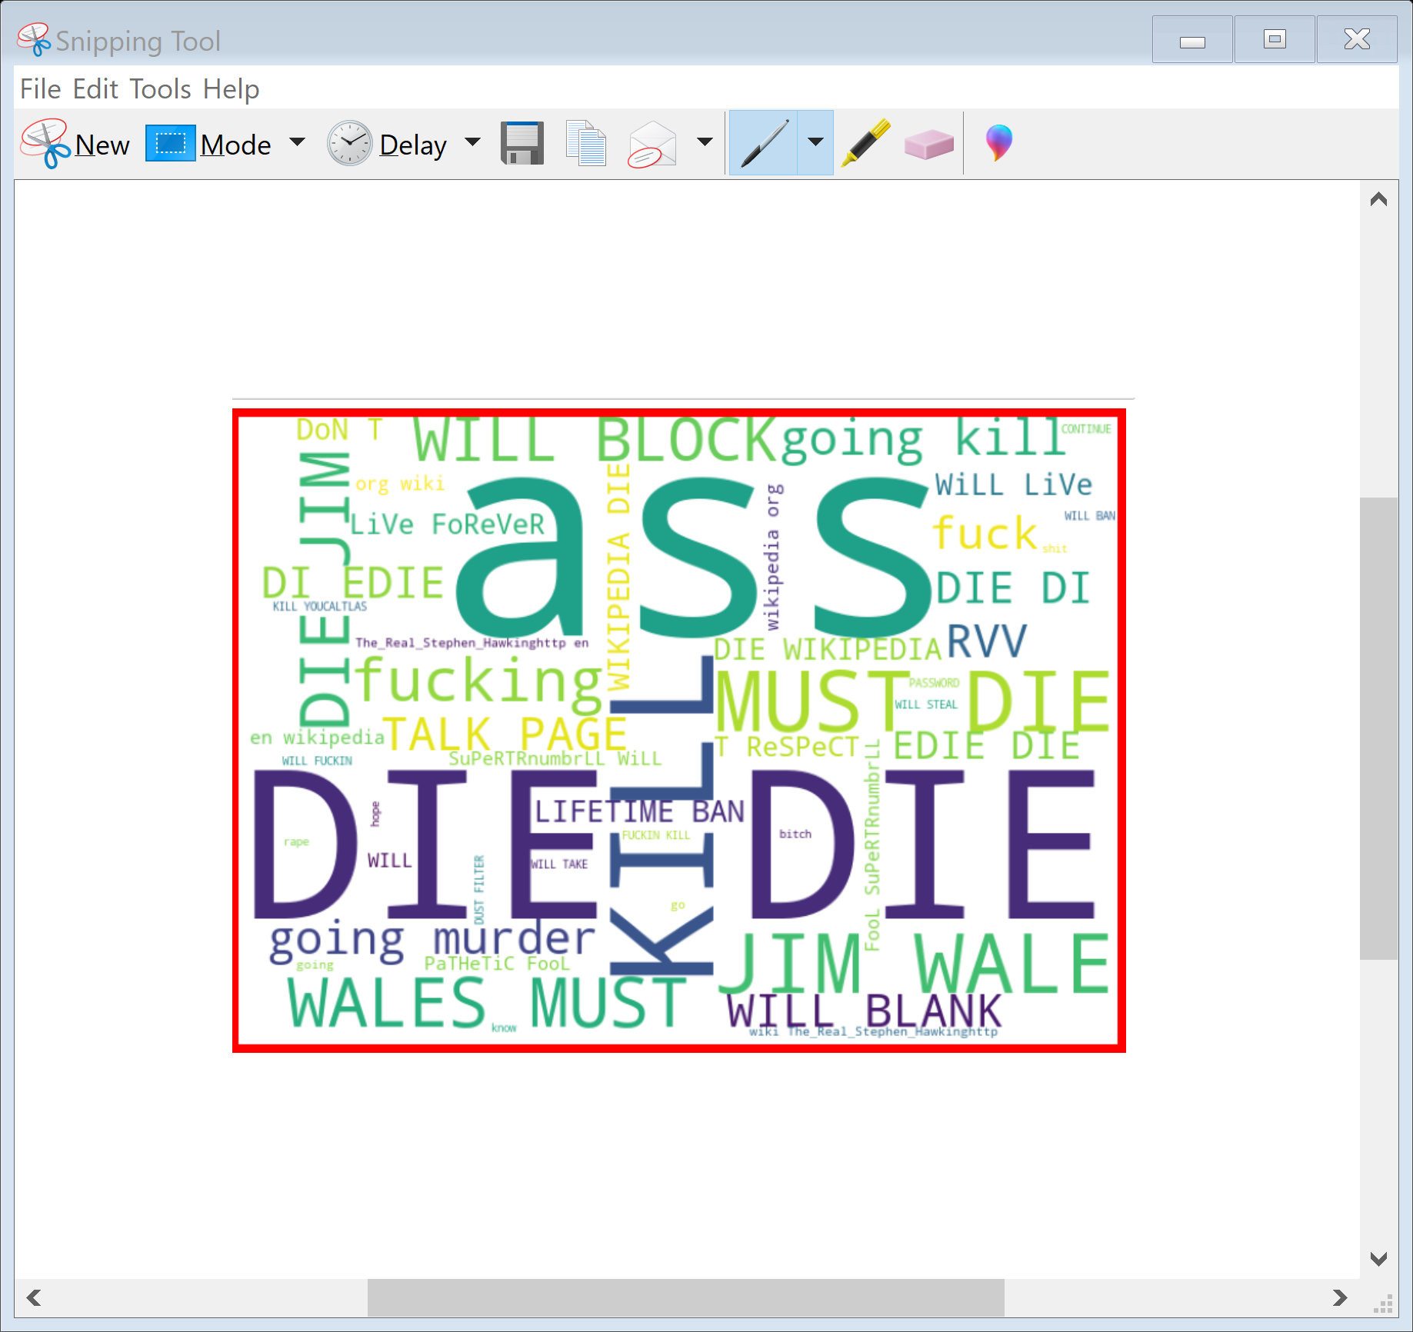
LET’S OBSERVE loud words in Comments which are marked as THREAT

Slide 16
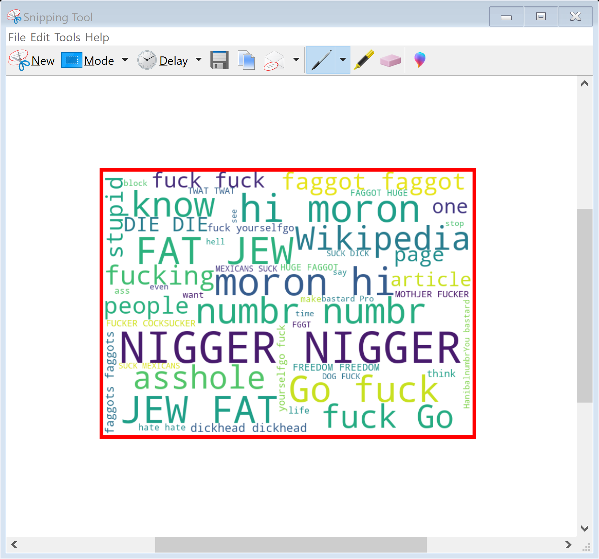
LET’S OBSERVE loud words in Comments which are marked as ABUSE

Slide 17
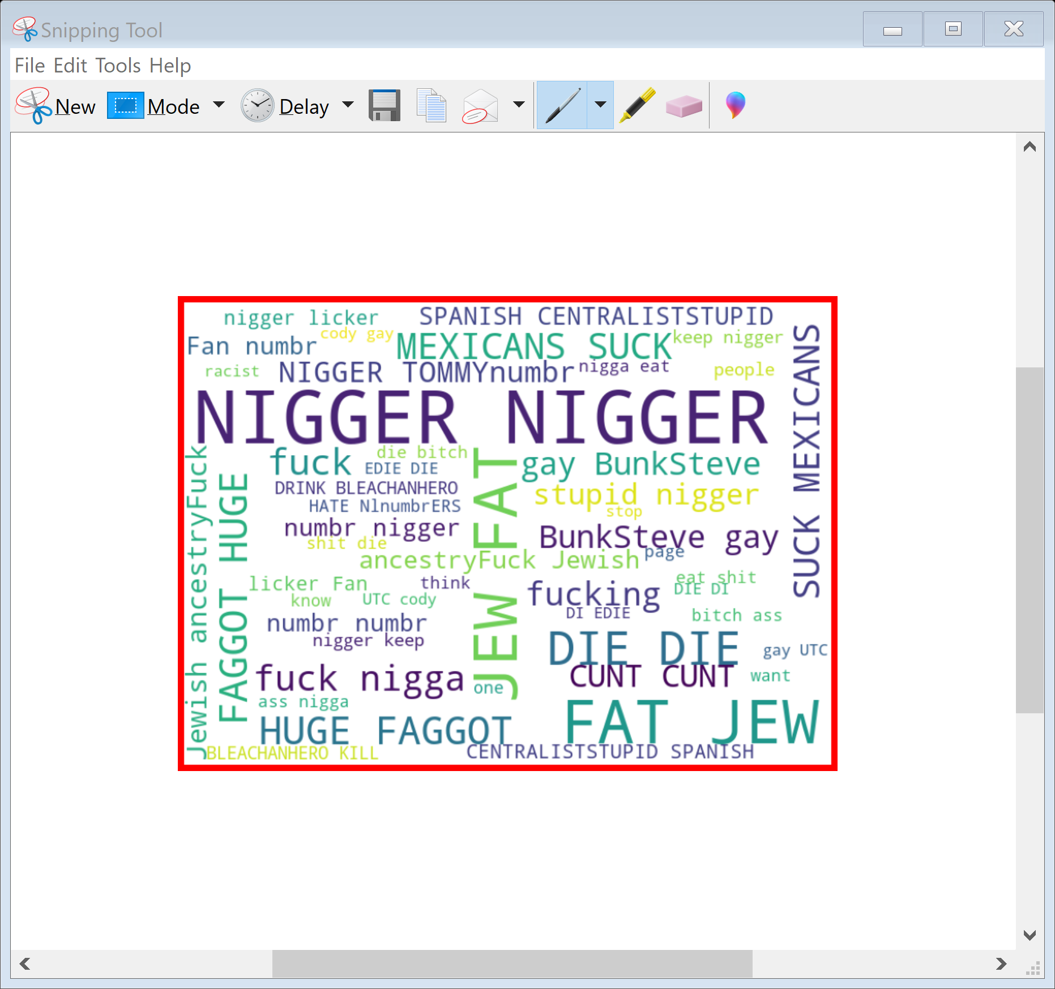
LET’S OBSERVE loud words in Comments which are marked as LOATHE

Slide 18
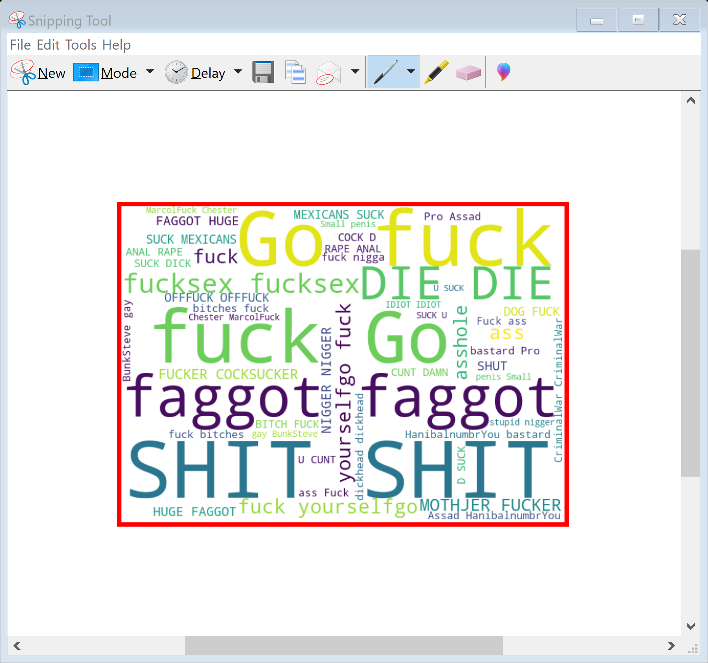
LET’S OBSERVE loud words in Comments which are marked as HIGHLY MAGLINANT

Slide 19
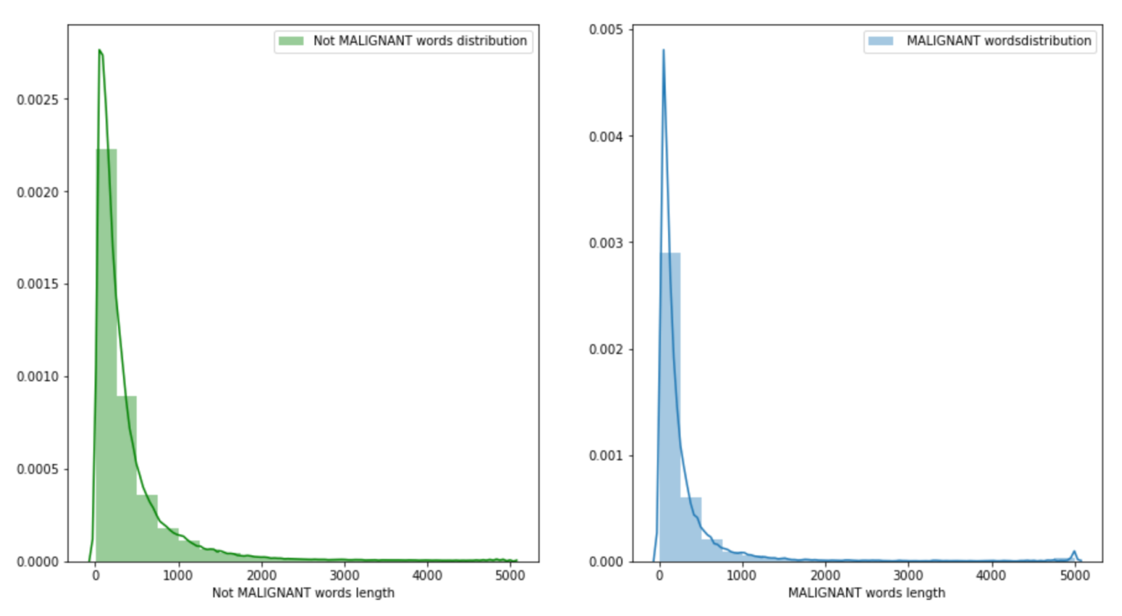
Comments length distribution BEFORE cleaning

Slide 20
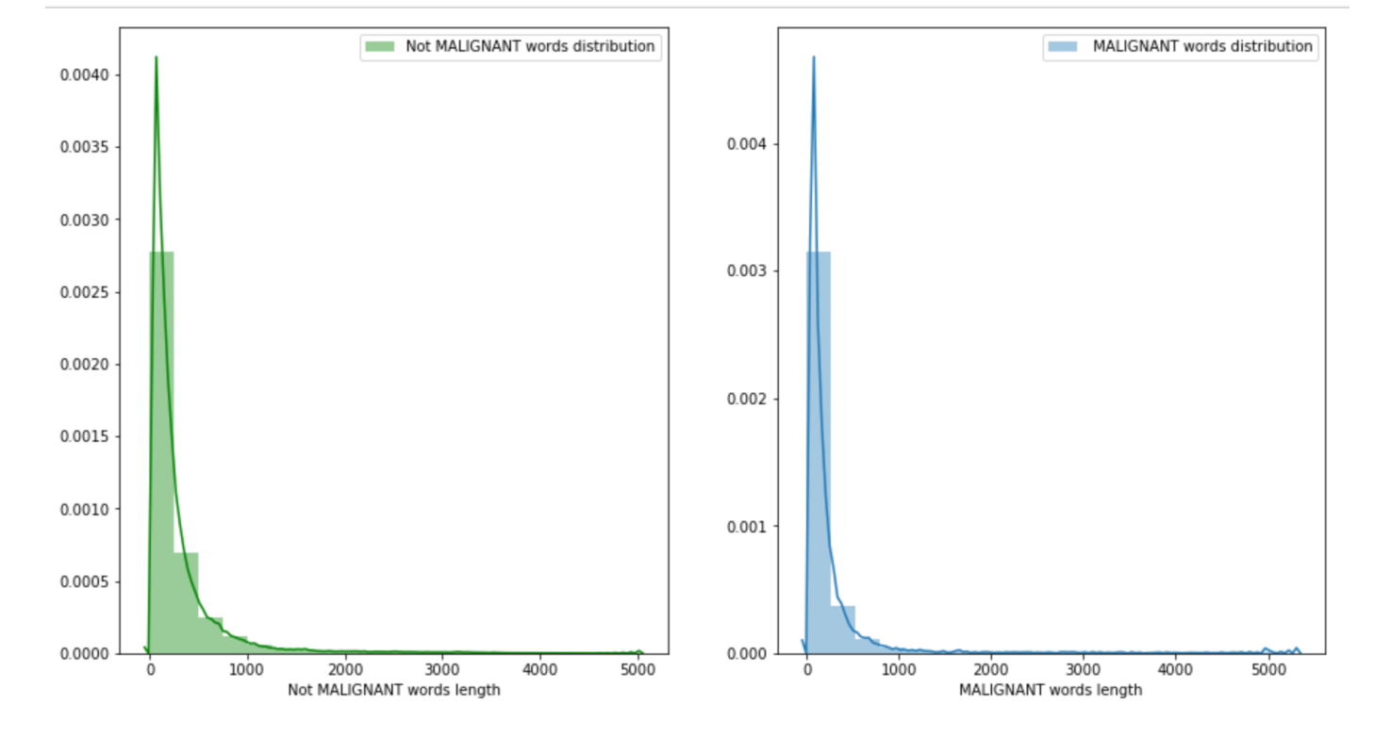
Comments length distribution after cleaning

Slide 21
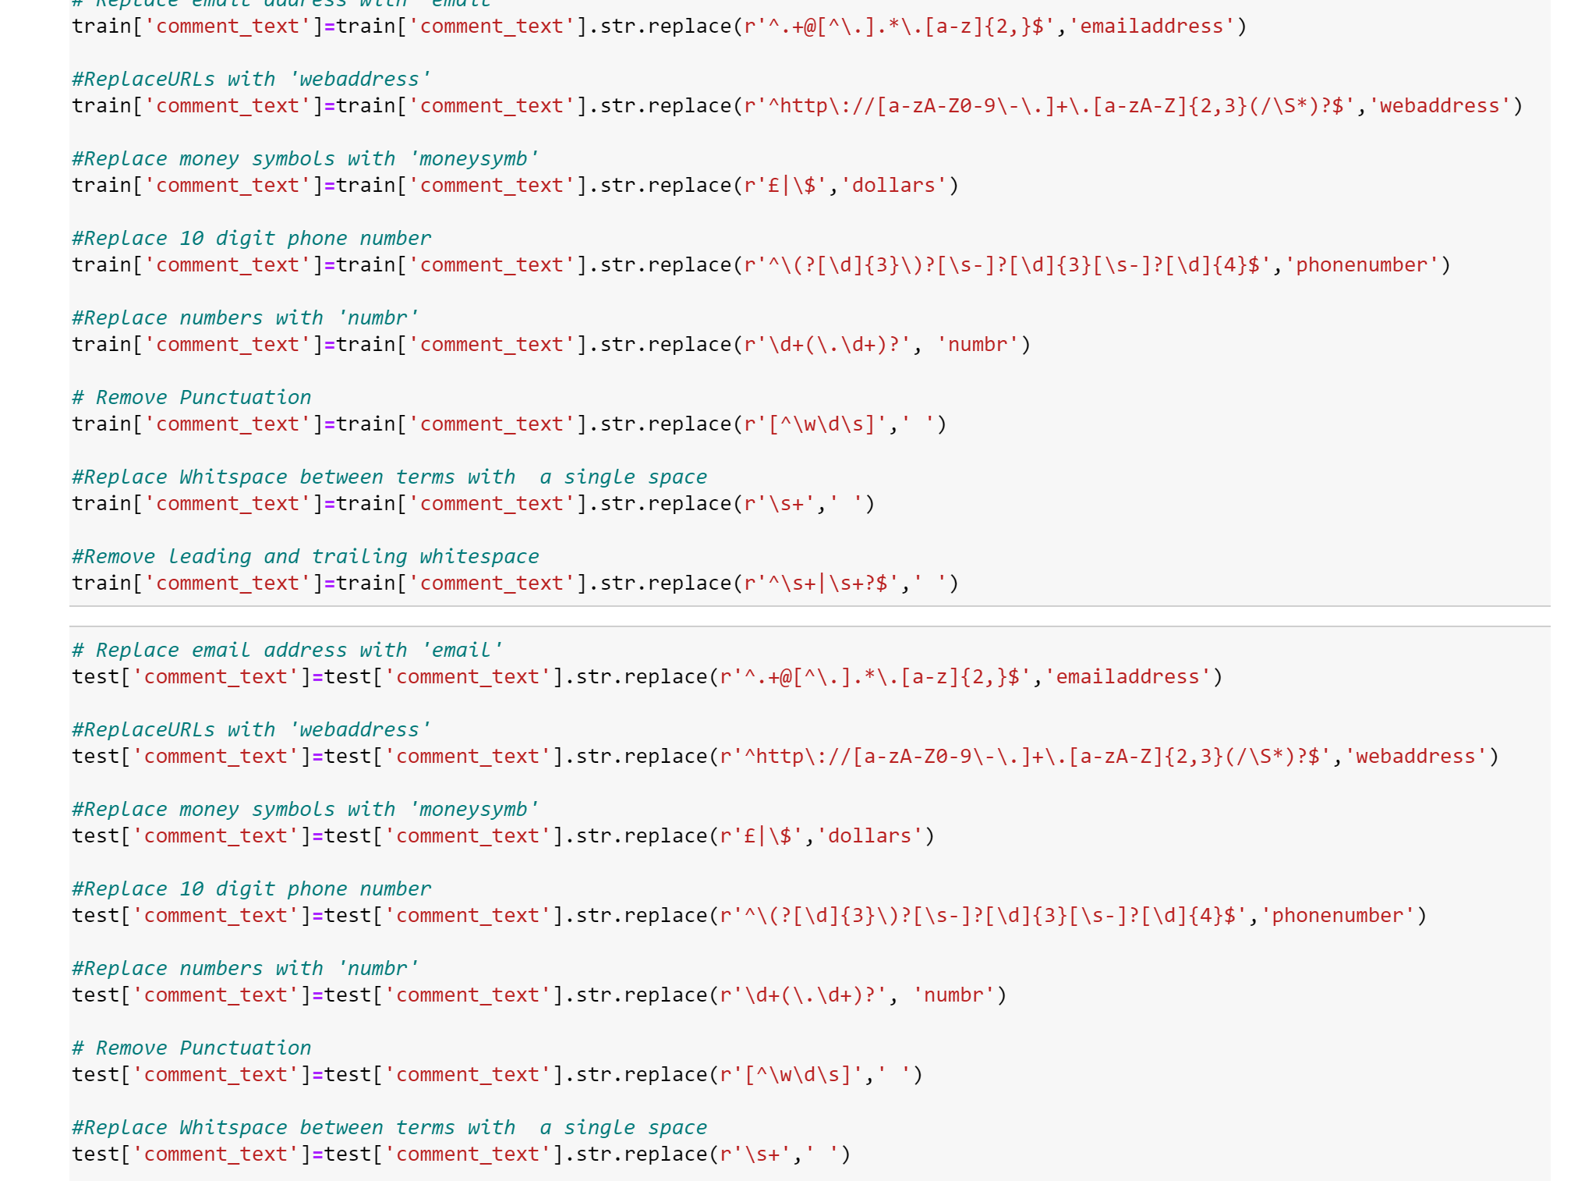
DATA CLEANING

Slide 22
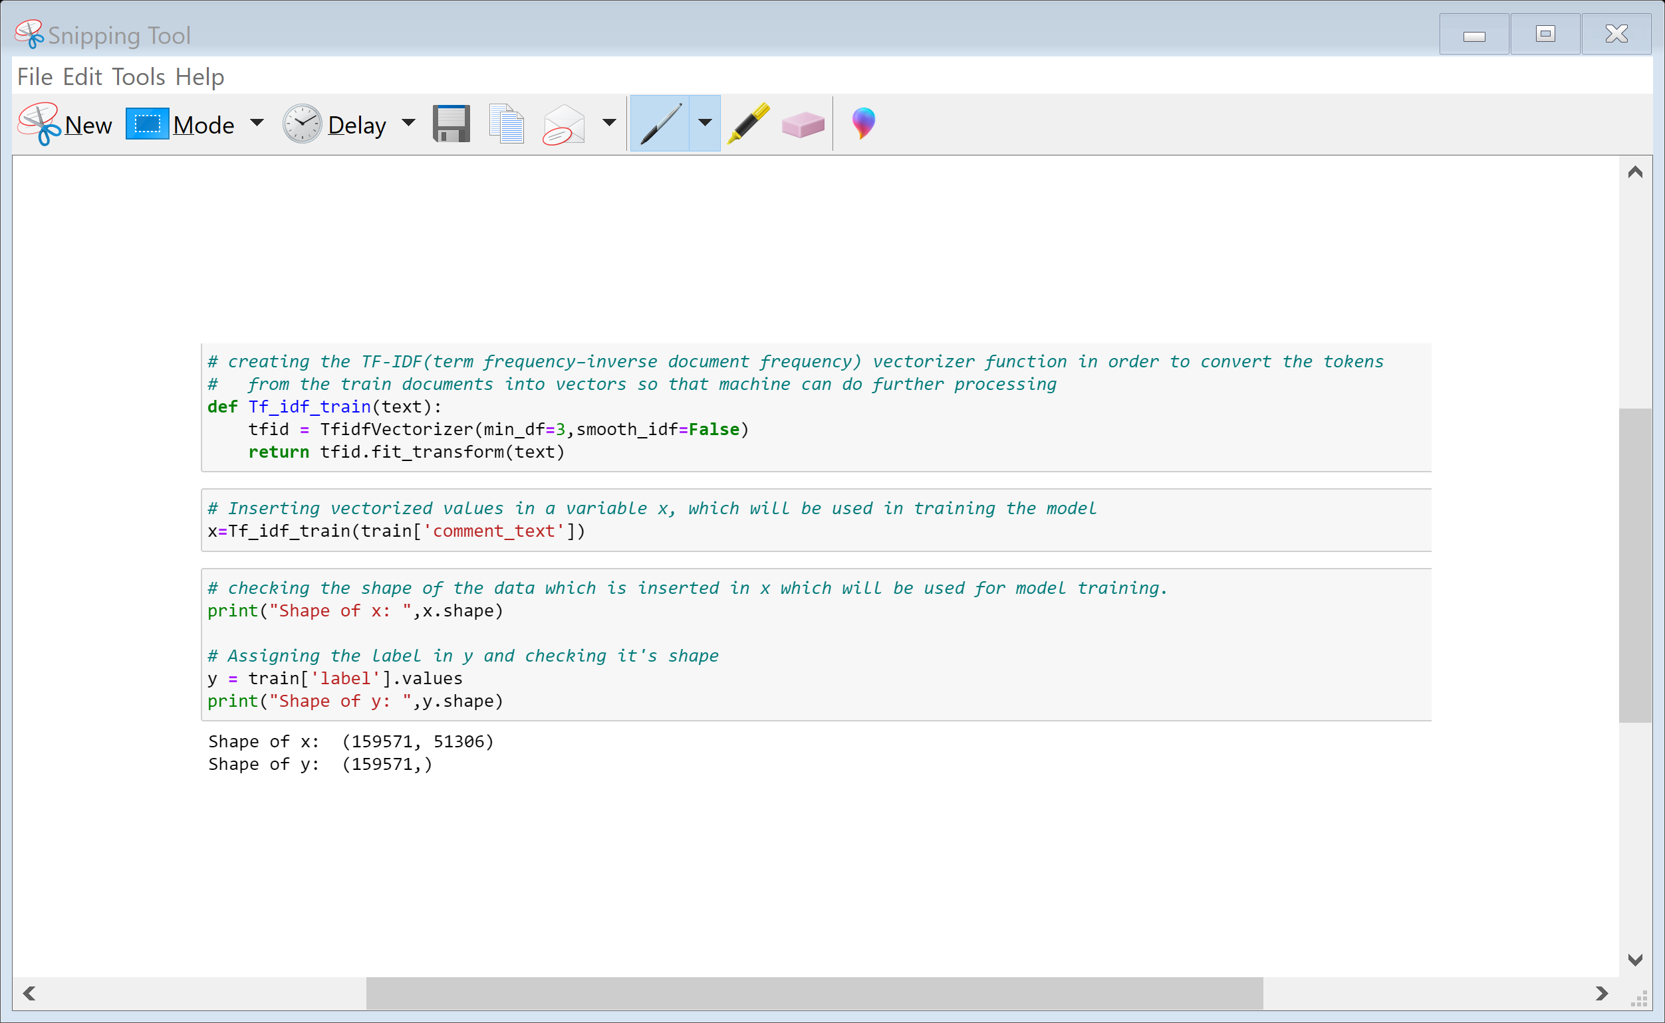
APPLYING TF-IDF TO CONVERT DATA INTO VECTORS AND SPLITTING DATA INTO INPUT AND TARGET VARIABLE

Slide 23
MODEL/S DEVELOPMENT AND EVALUATION
Read the use case and search from the google to know more about the use case and in which field or domain it will applicable more.
As data set is already there, so this step is excluded.
Data Preparation includes the data cleaning and describing the data which I followed text pre-processing.
EDA involves the visualization which is helpful to get more insight from the data and get to know about the mostly use comment and check the most frequent words.
Modelling involves creating the model with suitable algorithm which provide the best result, I tried multiple algo and apply hyperparameter tuning.
Model Evaluation, for this I used confusion metrices and mainly focus on False negative and tried to reduce the False negative which is type 2 error and on F1 score as dataset is imbalance.

Slide 24
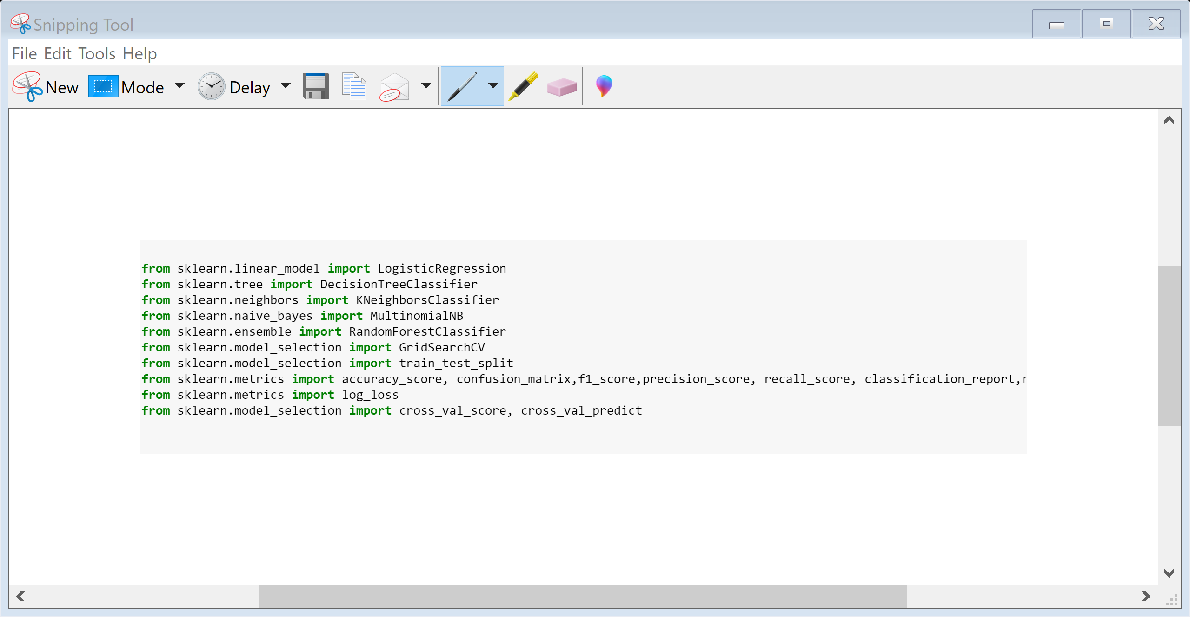
IMPORTING NECESSARY LIBRARIES

Slide 25
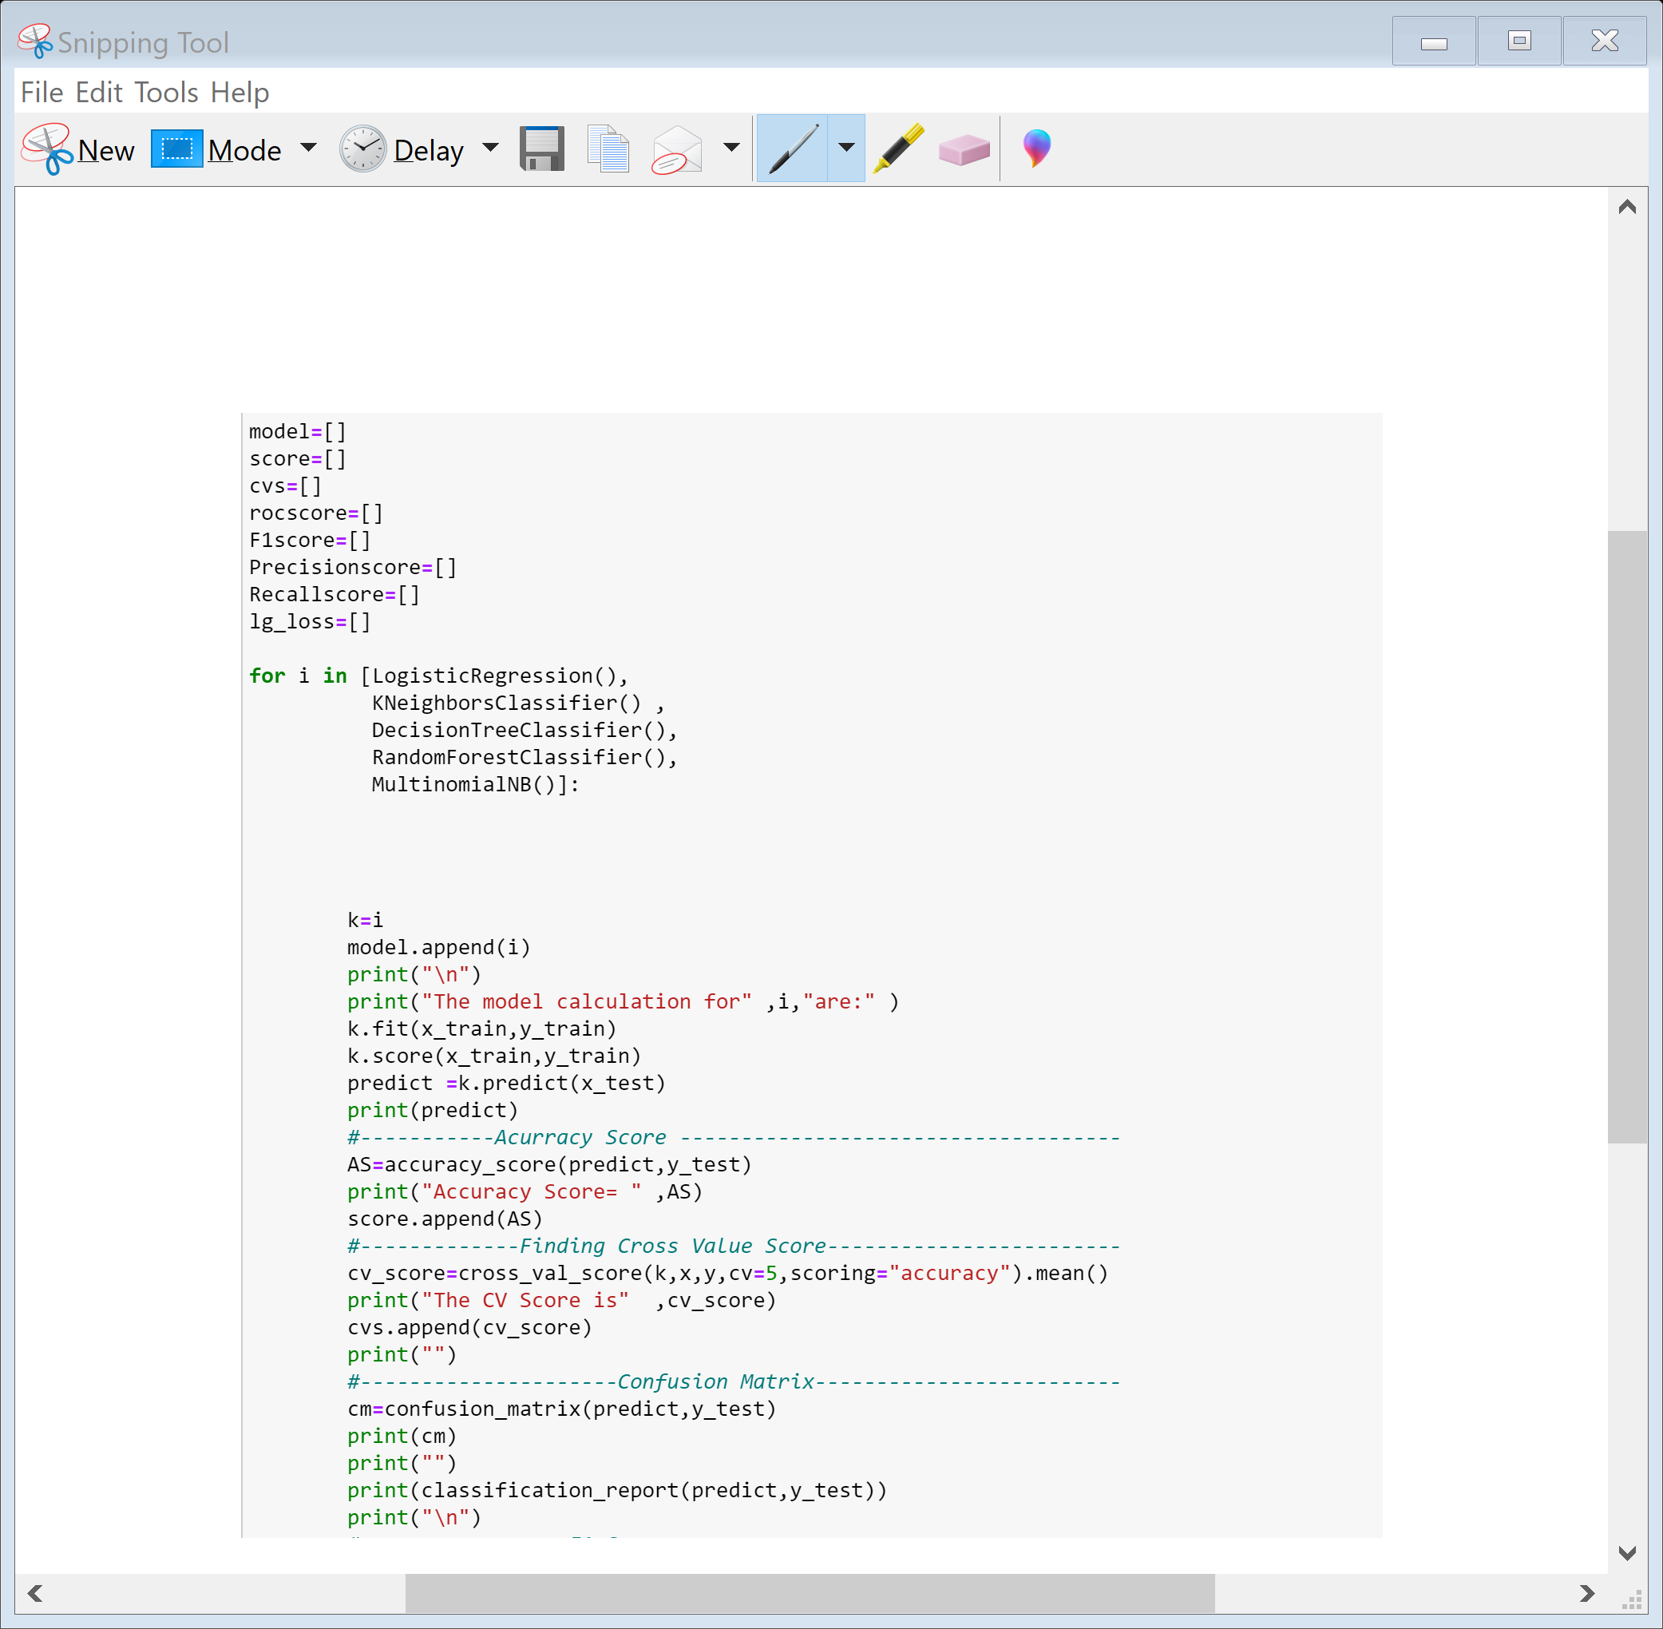
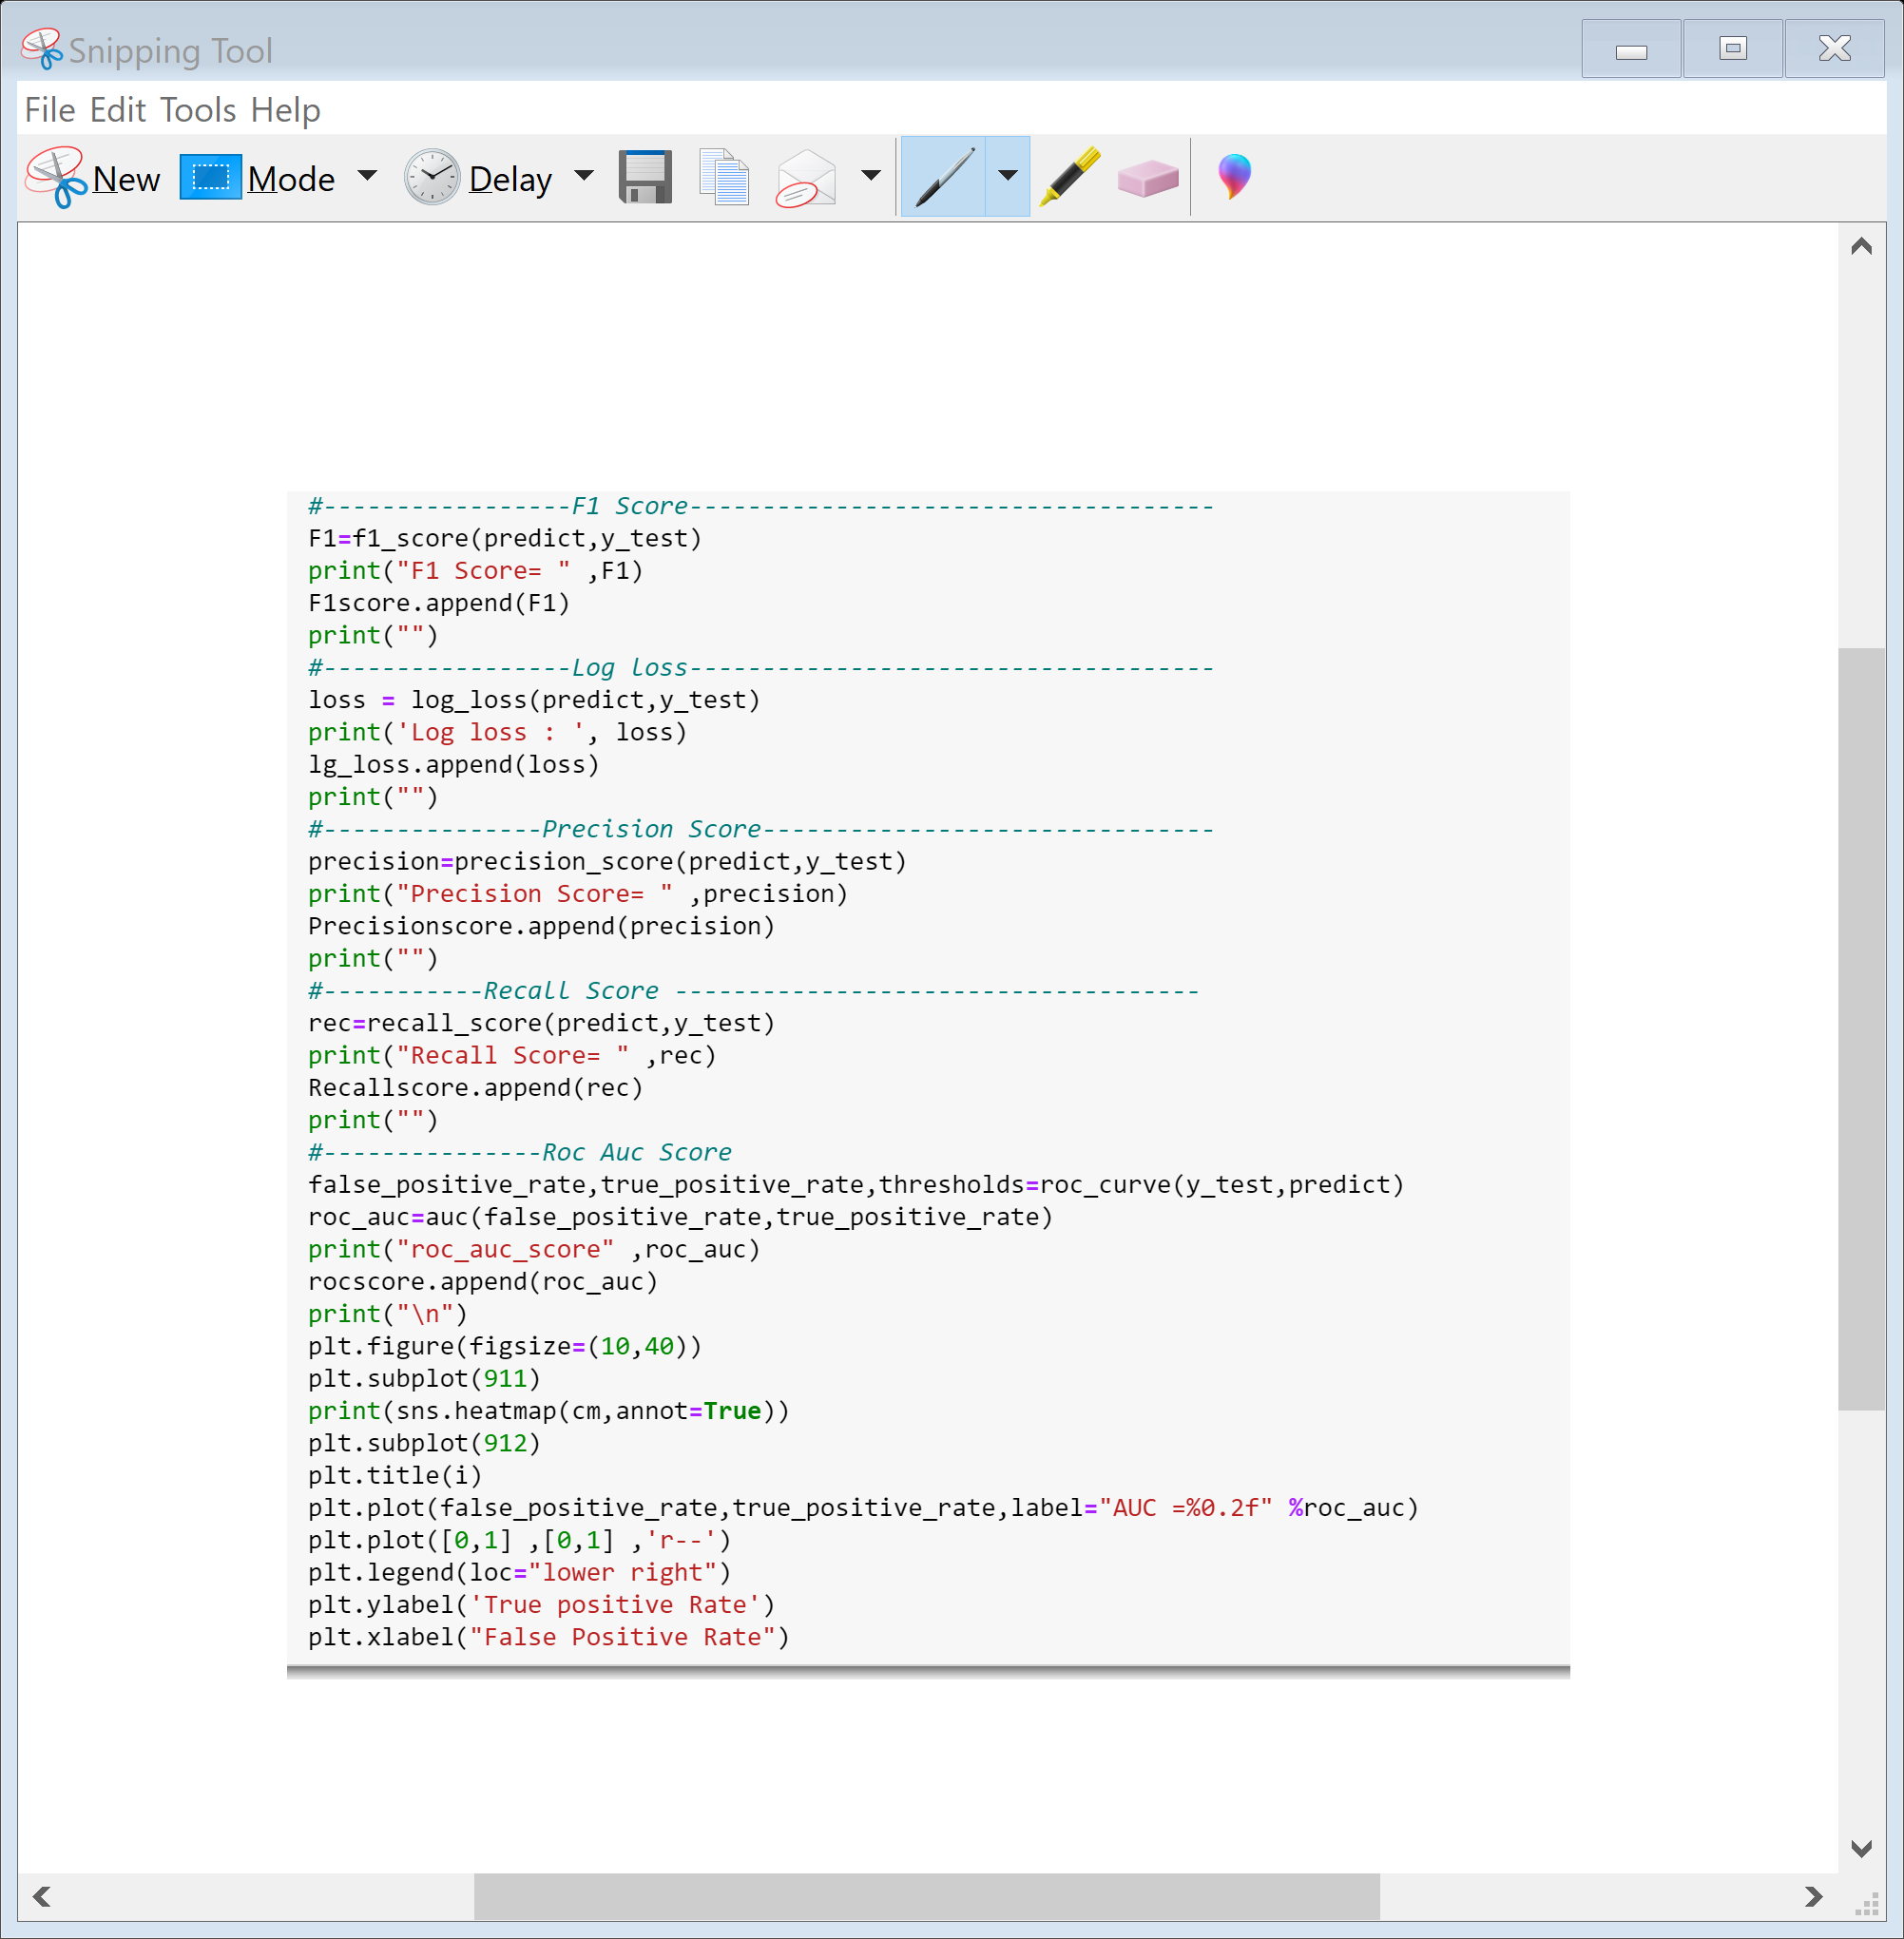
Run and Evaluated Some Selected models

Slide 26
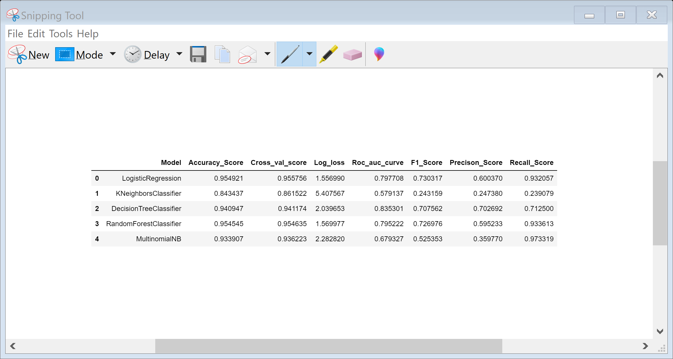
Key Metrics for success in solving problem under consideration
From the above analysis w.r.t Accuracy score, Cross value score and F1 score Random Forest Classifier is performing best¶

Slide 27
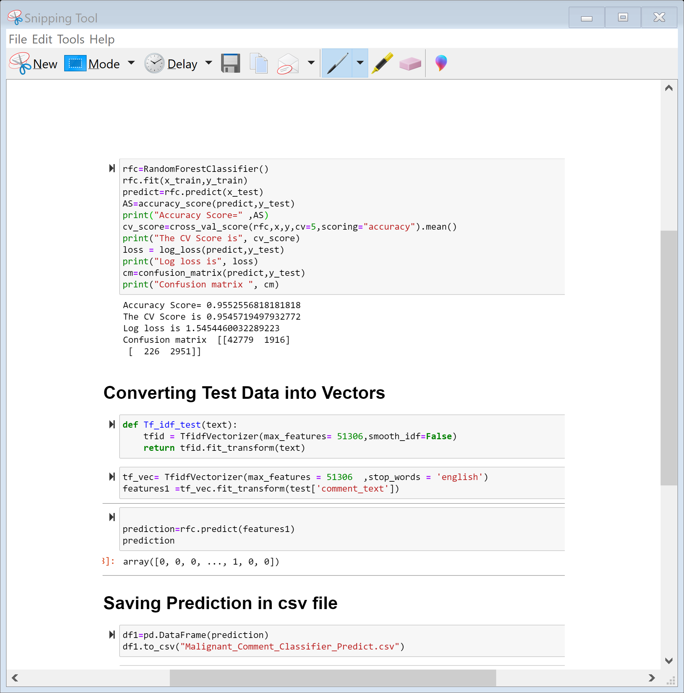
AFTER RUNNING ALL THE MODEL WW WILL CHOOSE RANDOM FOREST CLASSIFIER AS OUR FINAL MODEL TO PREDICT TEST DATA AND BEFORE THIS WILL CONVERT TEST DATA INTO VECTORS BY USING TF-IDF

Slide 28
Key Findings and Conclusions of the Study
Online hate, described as abusive language, aggression, cyberbullying, hatefulness and many others has been identified as a major threat on online social media platforms. Social media platforms are the most prominent grounds for such toxic behaviour.
From the above analysis the below mentioned results were achieved which depicts the
chances and conditions of a comment being a hateful comment or a normal comment.
With the increasing popularity of social media, more and more people consume feeds from social media and due differences they spread hate comments to instead of love and harmony. It has strong negative impacts on individual users and broader society.

Slide 29
Thank You

